Slide 1
Apriori Algorithm
جامعة البعث
الكلية التطبيقية
السنة الثالثة
قواعد معطيات 3
المحاضرة الأولى (عملي)
Prepered By
Eng : Danny Wassouf

Slide 2
Agenda
Data Mining
Association Rule
Apriori Algorithm
Graph Based Approach
Conclusion and Future Work

Slide 3
Data Mining
Data mining is the process of extracting patterns (knowledge) from data. The aim of data mining is to automate the process of finding interesting patterns and trends from a given data. It is seen as an increasingly important tool by modern business to transform data into business intelligence giving an informational advantage. It is currently used in a wide range of profiling practices, scientific discovery, and decision making.

Slide 4
Association Rules
Association rule learning is a popular and well researched method for discovering interesting relations between variables in large database.
For example, the rule found in the sales data of a supermarket would indicate that if a customer buys onions and potatoes together, he or she is likely to also buy burger. Such information can be used as the basis for decisions about marketing activities.

Slide 5
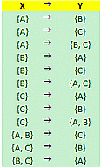
Problem Description
I = {A, B, C}
Possible Item sets:

Slide 6
Support and Confidence
Support (A -> B) =
No. of transactions containing A & B
________________________________
No. of total transactions
Confidence (A -> B) =
No. of transactions containing A & B
_________________________________
No. of transactions containing A

Slide 7
Apiriori Algorithm
A Candidate Generation and Test Approach
Method :
- Initially , Scan DB Once to get frequent 1-itemset .
- Generate length (K+1) candidate item sets .
- Test the candidate against DB .
- Terminate when frequent or candidate set can be generated

Slide 8
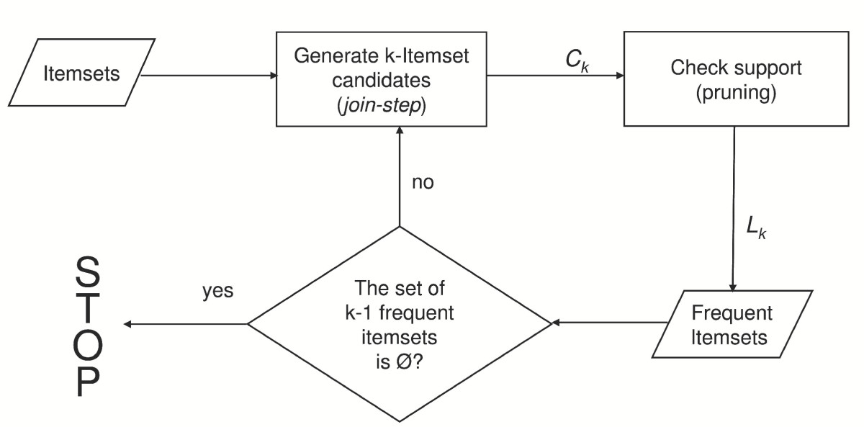
Original Apriori Algorithm

Slide 9
L1 = {large 1-itemsetsg}
for ( k = 2; Lk !=0, k++ )
do begin
Ck = apriori-gen(Lk-1 ); // New candidates
for all transactions tЄD
do begin
Ct = subset (Ck , t); // Candidates contained in t
for all candidates cЄCt do
c.count++;
end
Lk = {c Є Ck | c.count >= minsup}
end

Slide 10
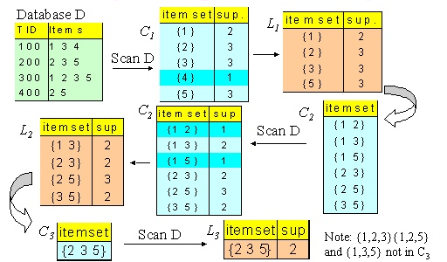

Slide 11
Graph based approach
Procedure FrequentItemGraph (Tree, F)
{
scan the DB once to collect the frequent 2-itemsets
and their support ascending;
add all items in the DB as the header nodes
for each 2-itemset entry (top down order) in freq2list
do
if (first item = item in header node) then
create a link to the corresponding header node i=3
for each i-itemsets entry in the tree
do
call buildsubtree (F)
end }
Procedure buildsubtree (F)
If (first i-1 itemset = itemsets in their respective header nodes) then
create a link to the corresponding header node i=i+1
repeat buildsubtree (F)
end }

Slide 12
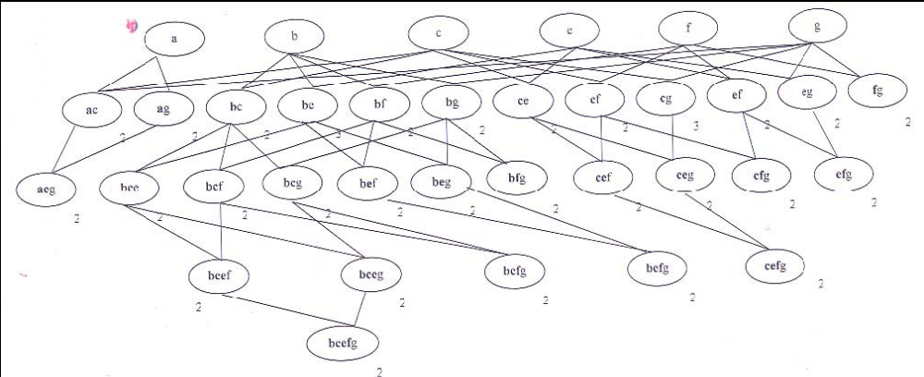
Example:
Transaction | Items
T1 | b e
T2 | a b c e f g
T3 | b c e f g
T4 | a c g

Slide 13
Conclusion and Future Work
Finally we can say that Apiriori Algorithm is very benefit to make
decisions.
and get knowledge form our database.
In future we will improve our Algorithm to reduce Possibilities by using FP-Growth Algorithm.

